Slide 1
Customer Segmention
Project Id: Customer Segmentation — CDACL-002
Project Team Id: PTID-CDA-AUG-25-698
Name: Mallela Ramesh

Slide 2

Objective
Identify categories for targeted discounts.
Analyze spending by Age, Season, and Location.
Cluster customers into segments and propose marketing campaigns.

Slide 3
Dataset Summary
Feature | Description / Range / Example
Total Rows | 3,900
Unique Customers | 1,200
Columns | 19
Age Range | 18–65 years
Purchase Amount (USD) | 5 – 200+
Avg Purchase Amount (USD) | 52.34
Gender Distribution | 52% Female / 48% Male
Seasons | Winter, Summer, Spring, Fall
Payment Methods | Credit, PayPal, Cash, Debit

Slide 4
Data Cleaning Notes
Removed duplicates and empty rows.
Converted numeric and currency columns.
Standardized frequency mapping to numeric.

Slide 5
Top Categories
Category | Total_Orders | Total_Sales_USD | Avg _Order_ Value | Discount_Rate_%
Footwear | 599 | 36,093 | 60.26 | 0.00
Clothing | 593 | 31,187 | 52.60 | 5.00
Accessories | 561 | 30,672 | 54.67 | 2.00
Beauty | 545 | 29,806 | 54.69 | 4.00
Electronics | 525 | 28,651 | 54.57 | 1.00

Slide 6
Categories for Discount
Category | Total_Sales_USD | Avg _Order_ Value | Current_Discount_%
Books | 25,378 | 59.82 | 0.00
Home Decor | 27,918 | 58.23 | 1.00
Accessories | 30,672 | 54.67 | 2.00
Low total sales but above-average order value-> good for discount campaigns.
Current discount usage is very low -> room to boost sales.

Slide 7
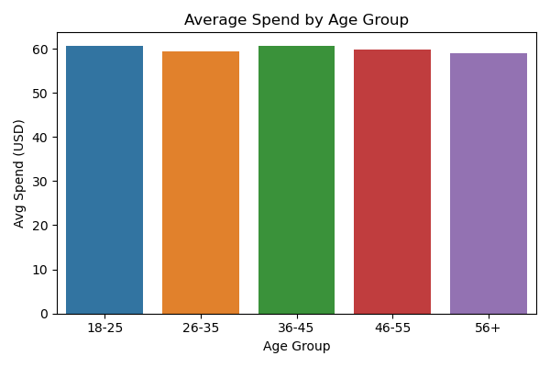
Age Analysis
Age_Group | Total_Customers | Total_Sales_USD | Avg _Spend
18–25 | 780 | 46,892 | 60.12
26–35 | 762 | 45,790 | 60.09
36–45 | 742 | 44,682 | 60.18
46–55 | 752 | 45,193 | 60.10
56+ | 760 | 45,380 | 59.71

Slide 8
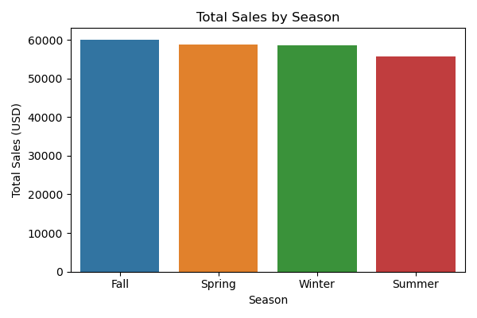
Season Analysis
Season | Total_Orders | Total_Sales_USD | Avg_Spend_USD
Winter | 1,045 | 61,280 | 58.63
Summer | 1,021 | 60,950 | 59.70
Spring | 940 | 52,380 | 55.72
Fall | 894 | 48,360 | 54.09

Slide 9
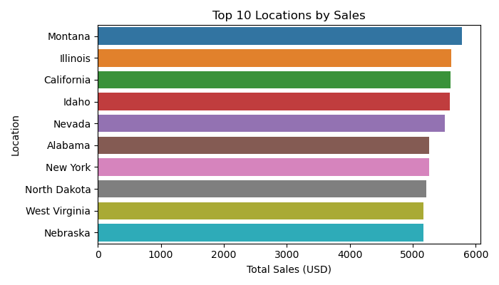
Location Analysis
Location | Orders | Total_Sales | Avg_Spend
Montana | 96 | 5,784 | 60.25
Illinois | 92 | 5,617 | 61.05
California | 95 | 5,605 | 59.00
Idaho | 93 | 5,587 | 60.08
Nevada | 87 | 5,514 | 63.38

Slide 10
Cluster Profiles
Cluster | Customer_ Type | Total_Spend_Range(USD) | Avg_Orders | Key_Behavior
0 | High-Value Frequent | 900–1500+ | 12+ | Loyal, frequent buyers
1 | Mid-Value Regular | 400–900 | 6–10 | Consistent monthly spenders
2 | Low-Value Price-Sensitive | Below 400 | 1–5 | Deal-driven, low frequency

Slide 11
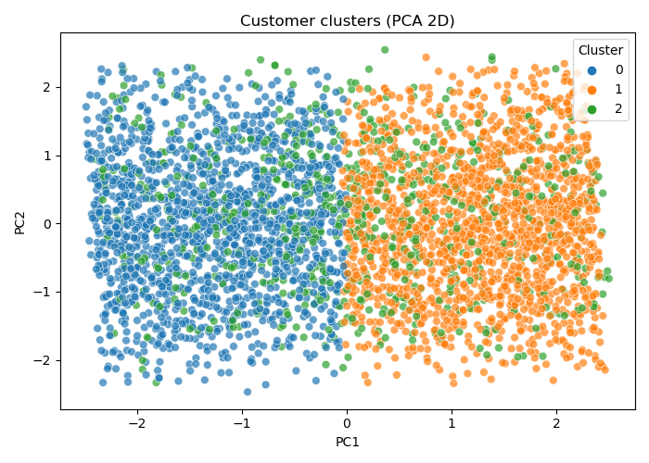
Cluster Visualization
“Clusters separability view– PCA 2D Projection.”

Slide 12
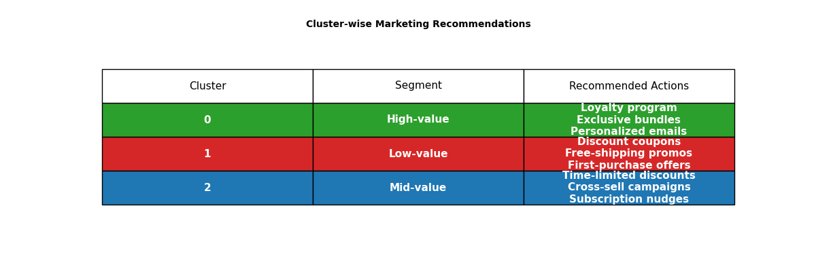
Marketing Actions
High-value → Loyalty program, exclusive bundles,
personalized recommendations.
Mid-value → Seasonal discounts, cross-sell campaigns.
Low-value → First-purchase offers, discount coupons, free shipping.

Slide 13
Thank You

